Slide 1


Program and Project Management
Notes:
Program and project management are essential for the successful delivery of complex initiatives. This introductory section provides an overview of the key roles, responsibilities, and collaborative nature of effective program and project management.

Slide 2

Program Management vs Project Management
Program Management:
Strategic Focus: Program management is strategically focused, ensuring that projects align with overall business objectives. Program managers oversee the alignment of project goals with business strategies, identify synergies between projects, and allocate resources efficiently to maximize impact. They monitor external factors, adapting the program's direction as needed for long-term relevance and competitiveness.
Project Management:
Tactical Focus: Project management is tactically focused on planning and executing specific project objectives. Project managers develop detailed project plans, allocate resources, manage risks, and coordinate team efforts to achieve project deliverables within scope, schedule, and budget constraints. Their primary focus is on the detailed implementation of the project's goals.

Slide 3
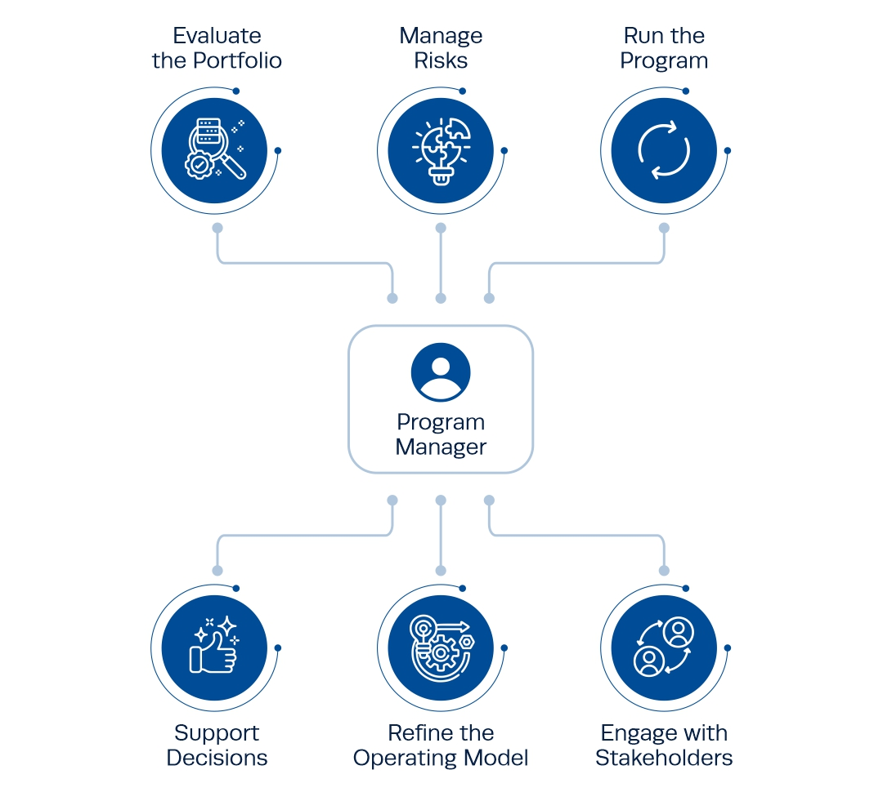

Slide 4

Subject Matter Experts and Module Experts
Subject Matter Experts (SMEs)
Facilitating Communication and Providing Leadership: SMEs act as a bridge between the project team and the organization, prioritizing functional requirements based on their expertise in specific business processes. They provide leadership and guidance, ensuring effective communication and smooth implementation.
Module Experts
Analyzing, Implementing, and Ensuring Functionality: Module Experts analyze requirements and translate them into solutions within the ERP system. They provide expertise in business process design, configuration, testing, training, and implementation to ensure that the ERP functions as intended.
Notes:
Subject Matter Experts (SMEs)
Facilitating Communication: SMEs facilitate communication between the project team and the organization by acting as a bridge.
Prioritizing Functional Requirements: They prioritize functional requirements based on their expertise in specific business processes.
Providing Leadership and Expertise: SMEs provide leadership and expertise in their respective areas, guiding the team through the implementation process.
Module Experts
Analyzing and Implementing Solutions: Module Experts analyze requirements and translate them into solutions within the ERP system.
Expertise in Business Processes: They provide expertise in business process design, configuration, testing, training, and implementation.
Ensuring ERP Functionality: Module Experts ensure that the ERP functions as intended by applying their knowledge and skills to configure and test the system.

Slide 5

PMO will likely need to monitor or address the following during an ERP implementation
Project start-up (Hiring the right staff and initial setup)
Interaction or goals between technical and functional staff
Commitment of senior management for the length of the project
Staff and professional consultant turnover
Second guessing project decisions

Slide 6

Critical Success Factors

Slide 7

Critical Success Factors
Decision-Making Process
1
A well-defined decision-making process will minimize a number of issues related to scope, efficiency, and productivity throughout the project implementation cycle.
2
Project Scope
Scope defines what needs to be delivered by the project, and a changing scope means the project will have difficulty in achieving project goals.
Teamwork
3
Project teams are assembled by bringing together staff from the existing organization, new hires, and possible external consultants and they need to work together for a common goal.
Notes:
عوامل النجاح الحاسمة
عملية إتخاذ القرار
إن عملية صنع القرار المحددة جيدًا ستقلل من عدد من المشكلات المتعلقة بالنطاق والكفاءة والإنتاجية طوال دورة تنفيذ المشروع.
نطاق المشروع
يحدد النطاق ما يجب أن يقدمه المشروع، ويعني النطاق المتغير أن المشروع سيواجه صعوبة في تحقيق أهداف المشروع.
العمل بروح الفريق الواحد
يتم تجميع فرق المشروع من خلال الجمع بين الموظفين من المنظمة الحالية والموظفين الجدد والمستشارين الخارجيين المحتملين، وهم بحاجة إلى العمل معً لتحقيق هدف مشترك.

Slide 8
Critical Success Factors
Change Management
4
It is up to the project manager to communicate the importance and significance of the project to the entire organization, top to bottom, through effective communication and training.
5
Implementation Team and Executive Team
The program manager and project manager are critical to a successful ERP implementation. There are three options in choosing an implementation team: the internal IT organization, consulting organizations, and the package software vendors. Executive management support and commitment throughout the project is essential.
Notes:
إدارة التغيير
الأمر متروك لمدير المشروع لإيصال أهمية المشروع وأهميته للمؤسسة بأكملها، من أعلى إلى أسفل، من خلال التواصل والتدريب الفعال.
فريق التنفيذ والفريق التنفيذي
يعد مدير البرنامج ومدير المشروع أمرًا بالغ الأهمية لنجاح تنفيذ نظام تخطيط موارد المؤسسات (ERP). هناك ثلاثة خيارات لاختيار فريق التنفيذ: منظمة تكنولوجيا المعلومات الداخلية، والمنظمات الاستشارية، وموردي برامج الحزمة. يعد دعم الإدارة التنفيذية والتزامها طوال المشروع أمرًا ضروريًا.

Slide 9
Managing Scope Creep
A well thought out process to manage changes to scope is critical to a project’s success.
If a key element of the functionality does not work well during this process, there may be a need to make changes to the original scope.
When changes are made in the scope of the project, the options, costs, and timeframe must be documented for the project to evaluate and decide a direction.
White Paper—Consists of a description of the issue or new functionality, including the options available with advantages and disadvantages.

Slide 10
Implications for Management
The success or failure of a project often rests with the skills and abilities of the PMO, project staff continuity, and a well-defined communications process.
The PMO must monitor a number of activities and issues throughout the length of the implementation.
The PMO needs to be sure that management is always informed and up to date on the project status.

Slide 11

Questions
What is the role of a project manager and program manager?
What are the skills, knowledge, and abilities required to be a project manager?
Name five critical success factors and why they are important to the success of a project.
What role can the company executives play in an implementation?
What is “scope creep” and why is it important to manage during an ERP implementation?
Notes:
Summary:-
Project management and the PMO must identify/monitor the critical success factors of an ERP implementation.
The PMO must address daily project priorities, and also focus on the business goals and to communicate them continually to the teams.
Scope creep happens when changes are requested that are not in the initially defined project scope.
Project leadership and the skills, knowledge and abilities of program and project managers are important ingredient to the success of an ERP implementation.
Project and program managers should work together closely during an implementation.

